Slide 1
Rooms
rooms, prepositions of place, “there is/there are”

Slide 2
Rooms - собе
Dear student, please go to this Youtube video: https://www.youtube.com/watch?v=R9intHqlzhc
and learn the new words*! You can do it! ☺
*научи све нове речи из видеа!

Slide 3
Vocabulary exercise
What do you see? Write your answer in your English notebook. Every sentence should start with: “This is a/an ____________”.*
For example: “This is a toilet.”
*У свесци напиши шта видиш на следећим слајдовима. Свака реченица треба да почне са: “This is a/an”.

Slide 4
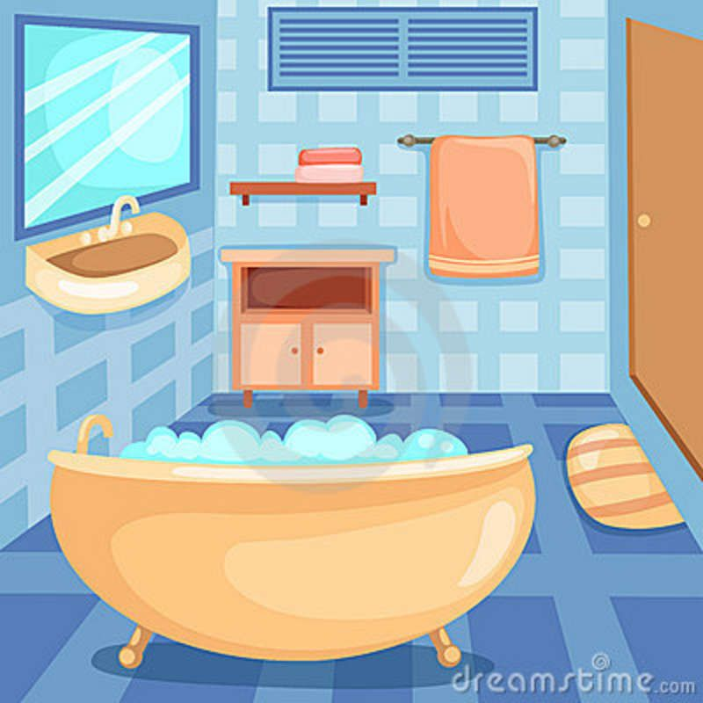
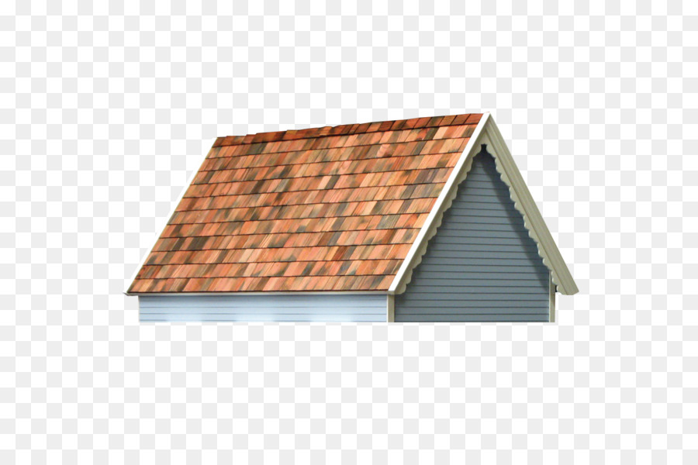


Slide 5
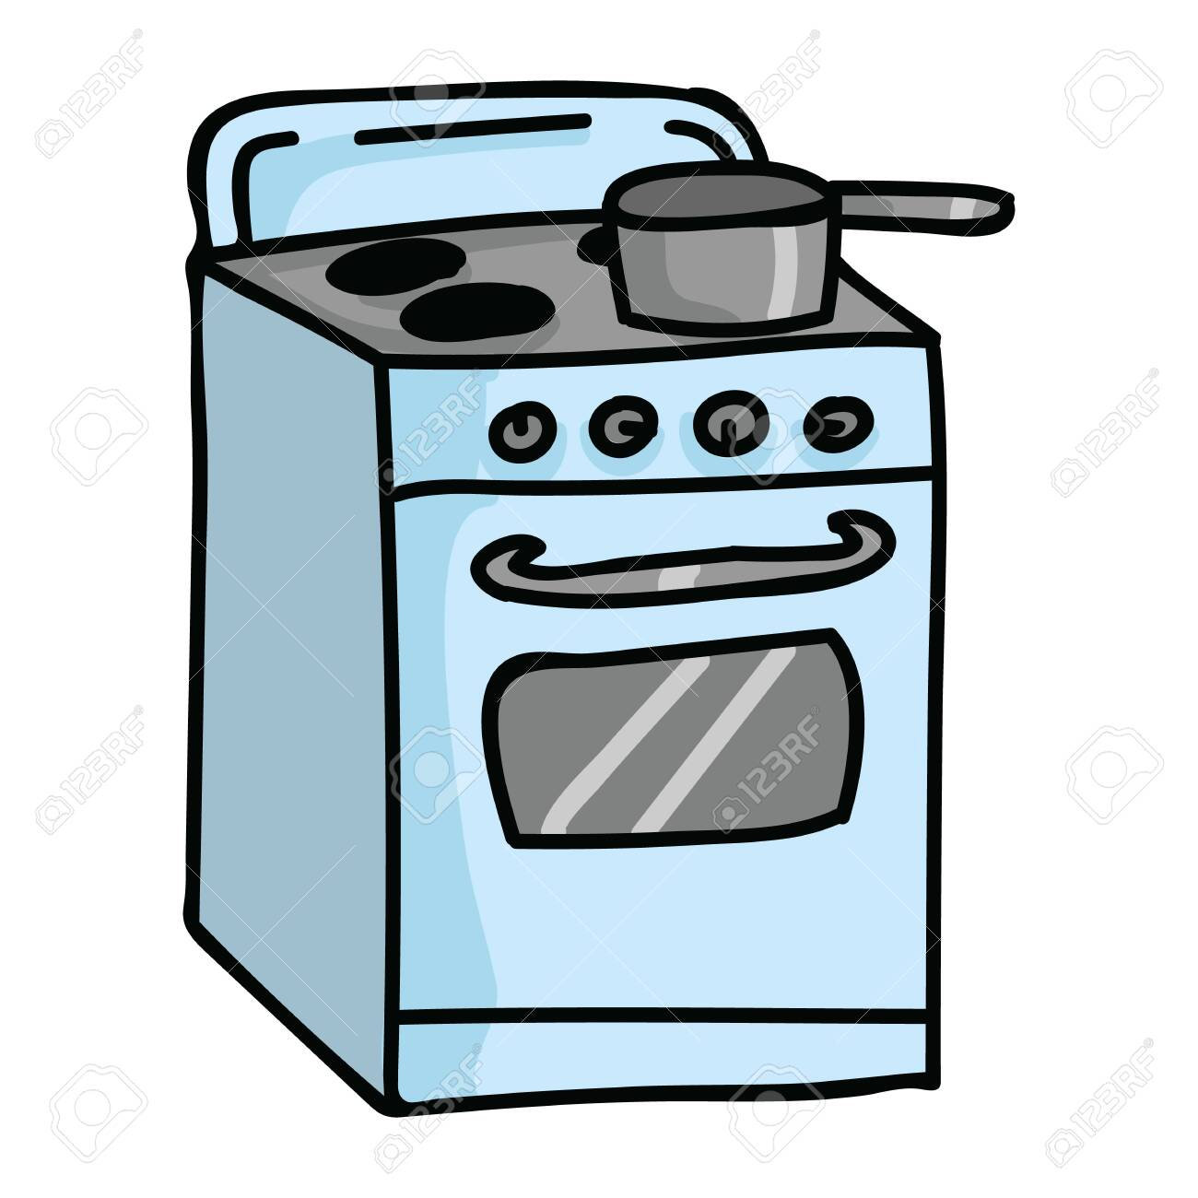

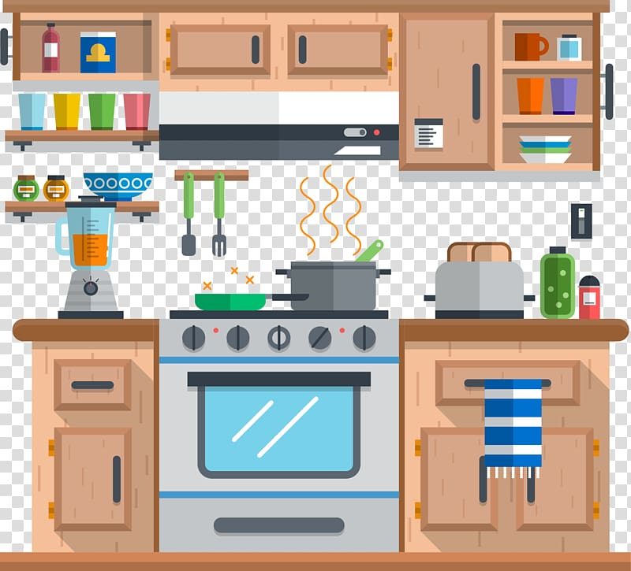

Slide 6
Prepositions (предлози места)
У овој лекцији ћемо научити четири предлога за место: НА, У,ИСПОД и ПОРЕД.
НА – ON (The book is ON the table).
У – IN (The cat is IN the box).
ИСПОД – UNDER (The dog is under the bed).
ПОРЕД – NEXT TO (The sink is next to the tub).

Slide 7
Prepositions
Dear student, please watch this video https://www.youtube.com/watch?v=5Tf0DLBkkzw and answer the questions from the next slide in your notebooks! * ☺
*На питања са следећих слајдова одговори у свеску енглеског!

Slide 8
Where is it?
Where’s the ball?
Where’s the carrot?
Where’s the donut?
Where’s the watch?

Slide 9
There is / There are
У којим ситуацијама користимо ове две фразе?

Slide 10
There is / There are користимо…
…када желимо да кажемо да се нешто негде налази.
Нпр: There is a sink in the bathroom. (У купатилу се налази лавабо.)

Slide 11
There is(1 thing) | a book an apple | There is a book on the table. There is an apple on the table.
There are(2+ things) | 2 books apples | There are 2 books on the table. There are apples on the table.

Slide 12
Is there(1 thing) | a book | Is there a book on the table?
Are there (2+ things) | apples | Are there apples on the table?

Slide 13
Extra explanation
Dear student, watch this video https://www.youtube.com/watch?v=qPgEaPBSjLM&list=PLSOgrsyzaoExWoaeLXFzAfUsDxWw9uzgW&index=35&t=0s for a more detailed explanation of there is/there are!

Slide 14
Homework
Watch this video https://www.youtube.com/watch?v=ZjhOgnROluo
and practise! ☺
Also, on page 58 in your textbook, you should do exercises 3 and 4.

